Slide 2

Notes:
Hello, everyone Our team is Shanghaitiech

Slide 3
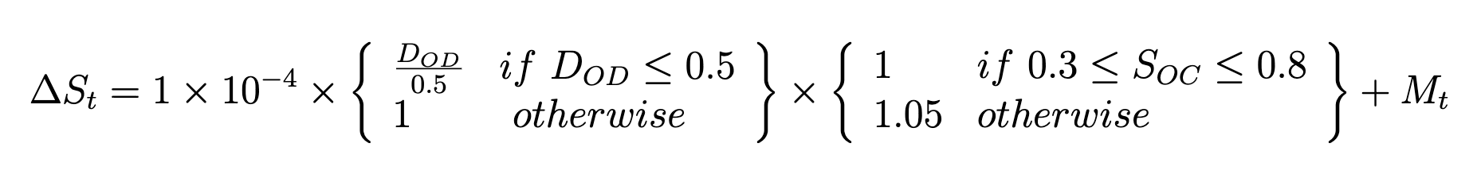


Question 2 Battery life DECAY
⬤⭘
Charge / Discharge
Transition Penalty:
~0.01
Extreme SOC Penalty:
~0.05
Notes:
We can rewrite the battery life decay formula as above. There are two multiplication factors and one additive factor. The amount of charge or discharge DOD contributes to a multiplication factor which caps at 1, which means we can use this non-linearity for up to 50% save. The extreme SOC penalty and transition penalties don’t contribute more than 0.01 of the base value, so we don‘t need to consider.

Slide 4
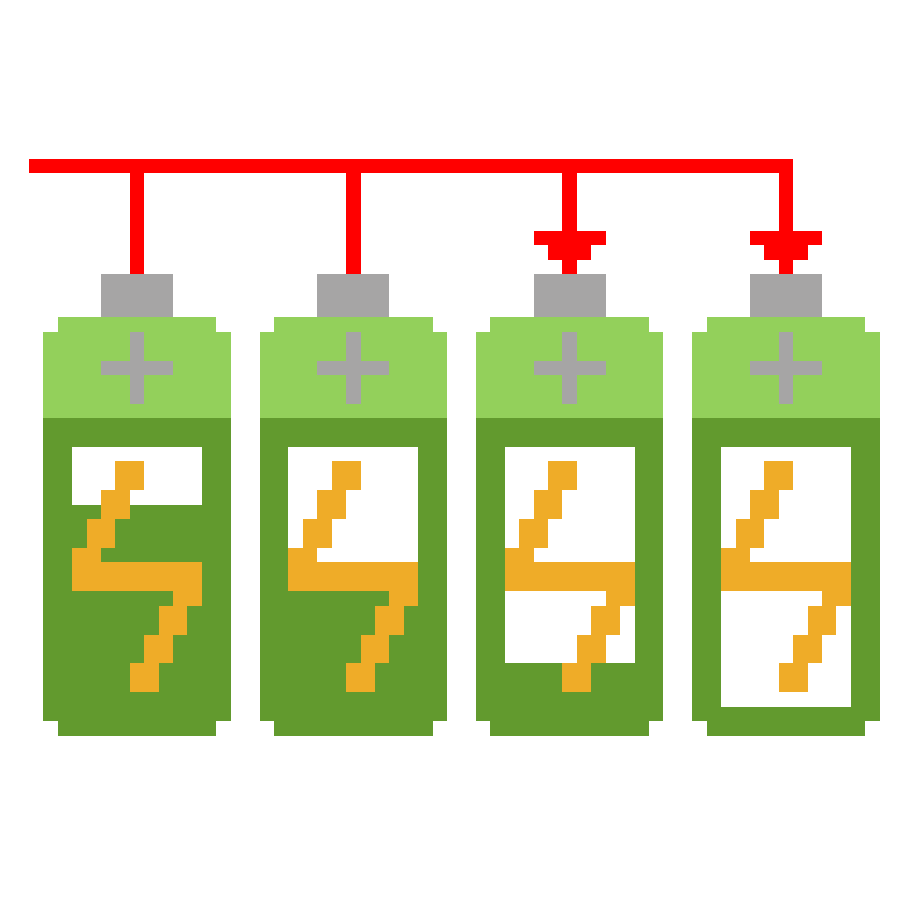

Question 2 Battery life DECAY
⭘⬤
Charge the most discharged
Discharge the most charged
Notes:
We implemented a greedy algorithm which takes most charged batteries for discharging and takes most discharged batteries for charging. The set of batteries is maintained by a STL balanced binary tree. Then we can use the most out of nonlinear caps as it’s impossible to avoid extreme SOCs under this strategy. This method saves almost half battery life than distributing charge and discharge tasks uniformly among the batteries.

Slide 5


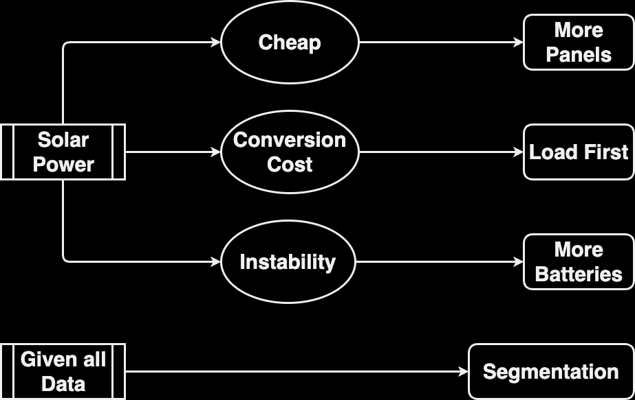







Question 1 Power scheduling——Intuition
⬤⭘⭘
Notes:
yhz

Slide 6
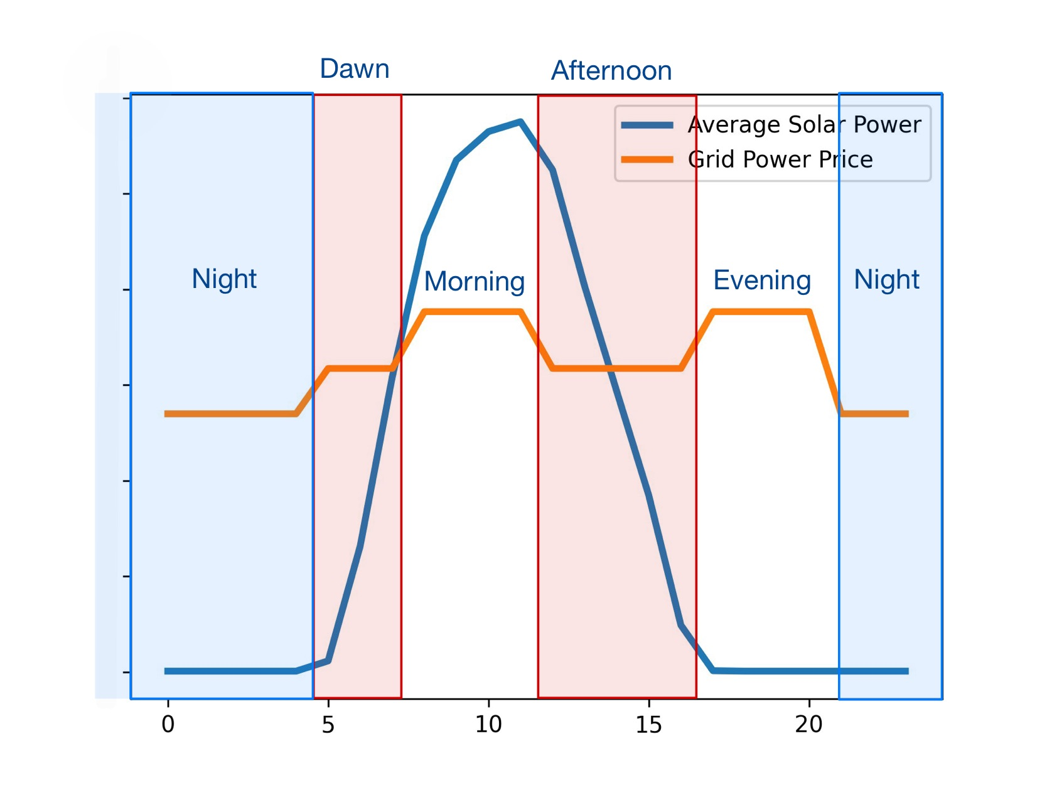
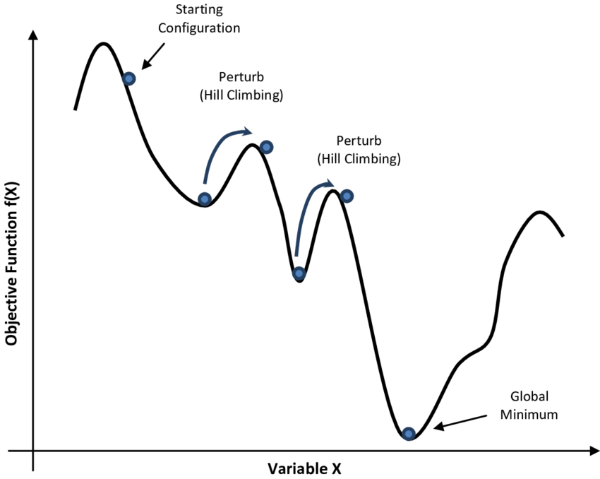
Question 1 Power scheduling——algorithm
⭘⬤⭘
Focusing on data
Simulated annealing
Notes:
yhz

Slide 7
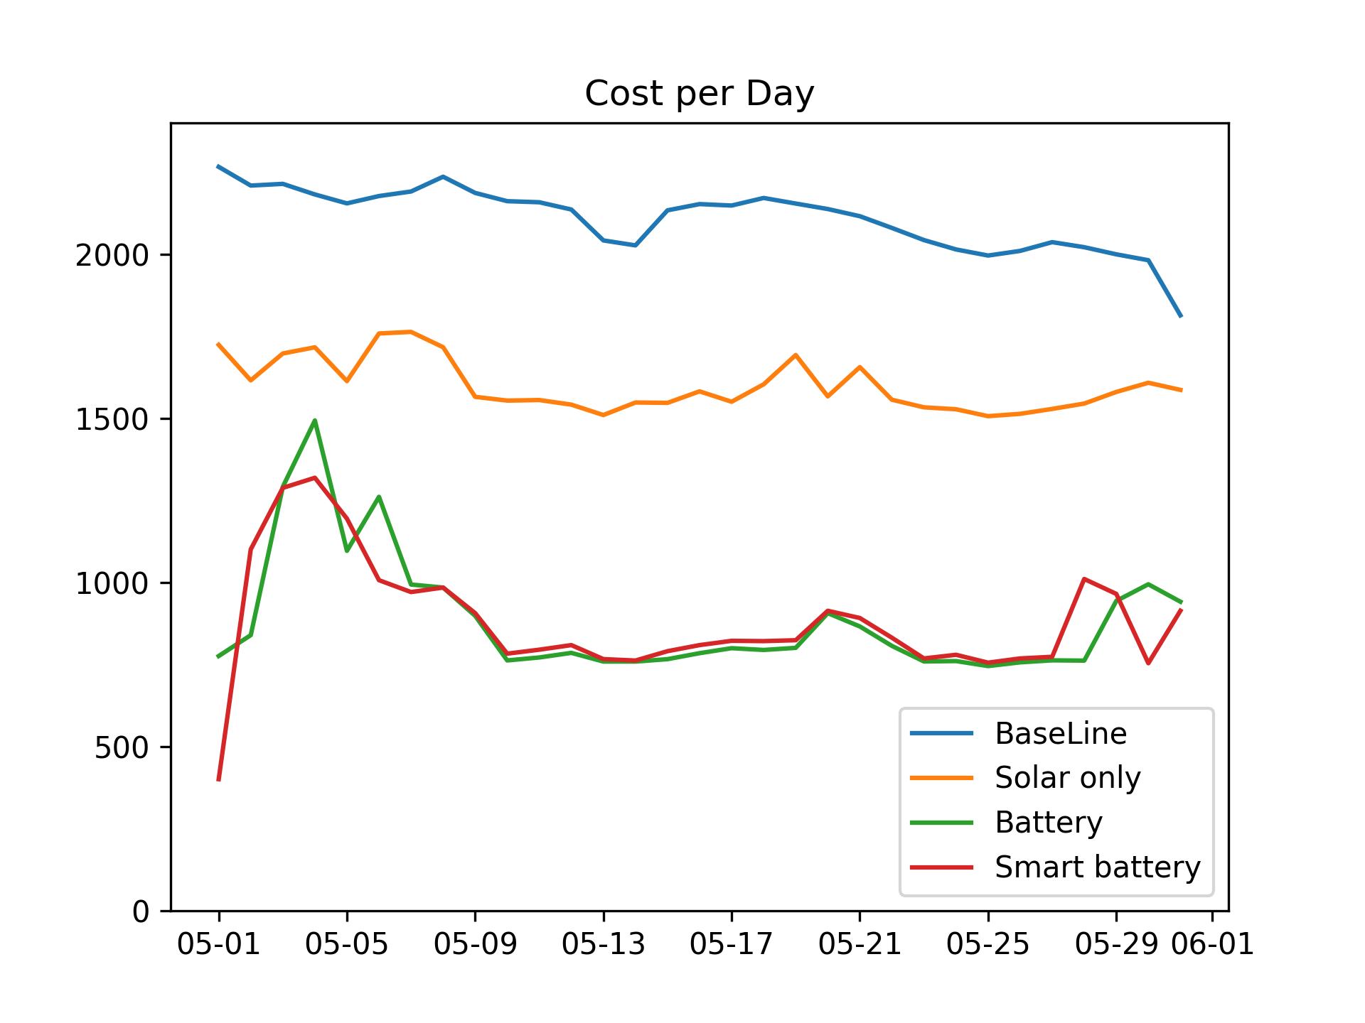
Question 1 Power scheduling – HOW SMART?
⭘⭘⬤
FOUR Algorithms
Larger Battery pack?
Notes:
Cst

Slide 8
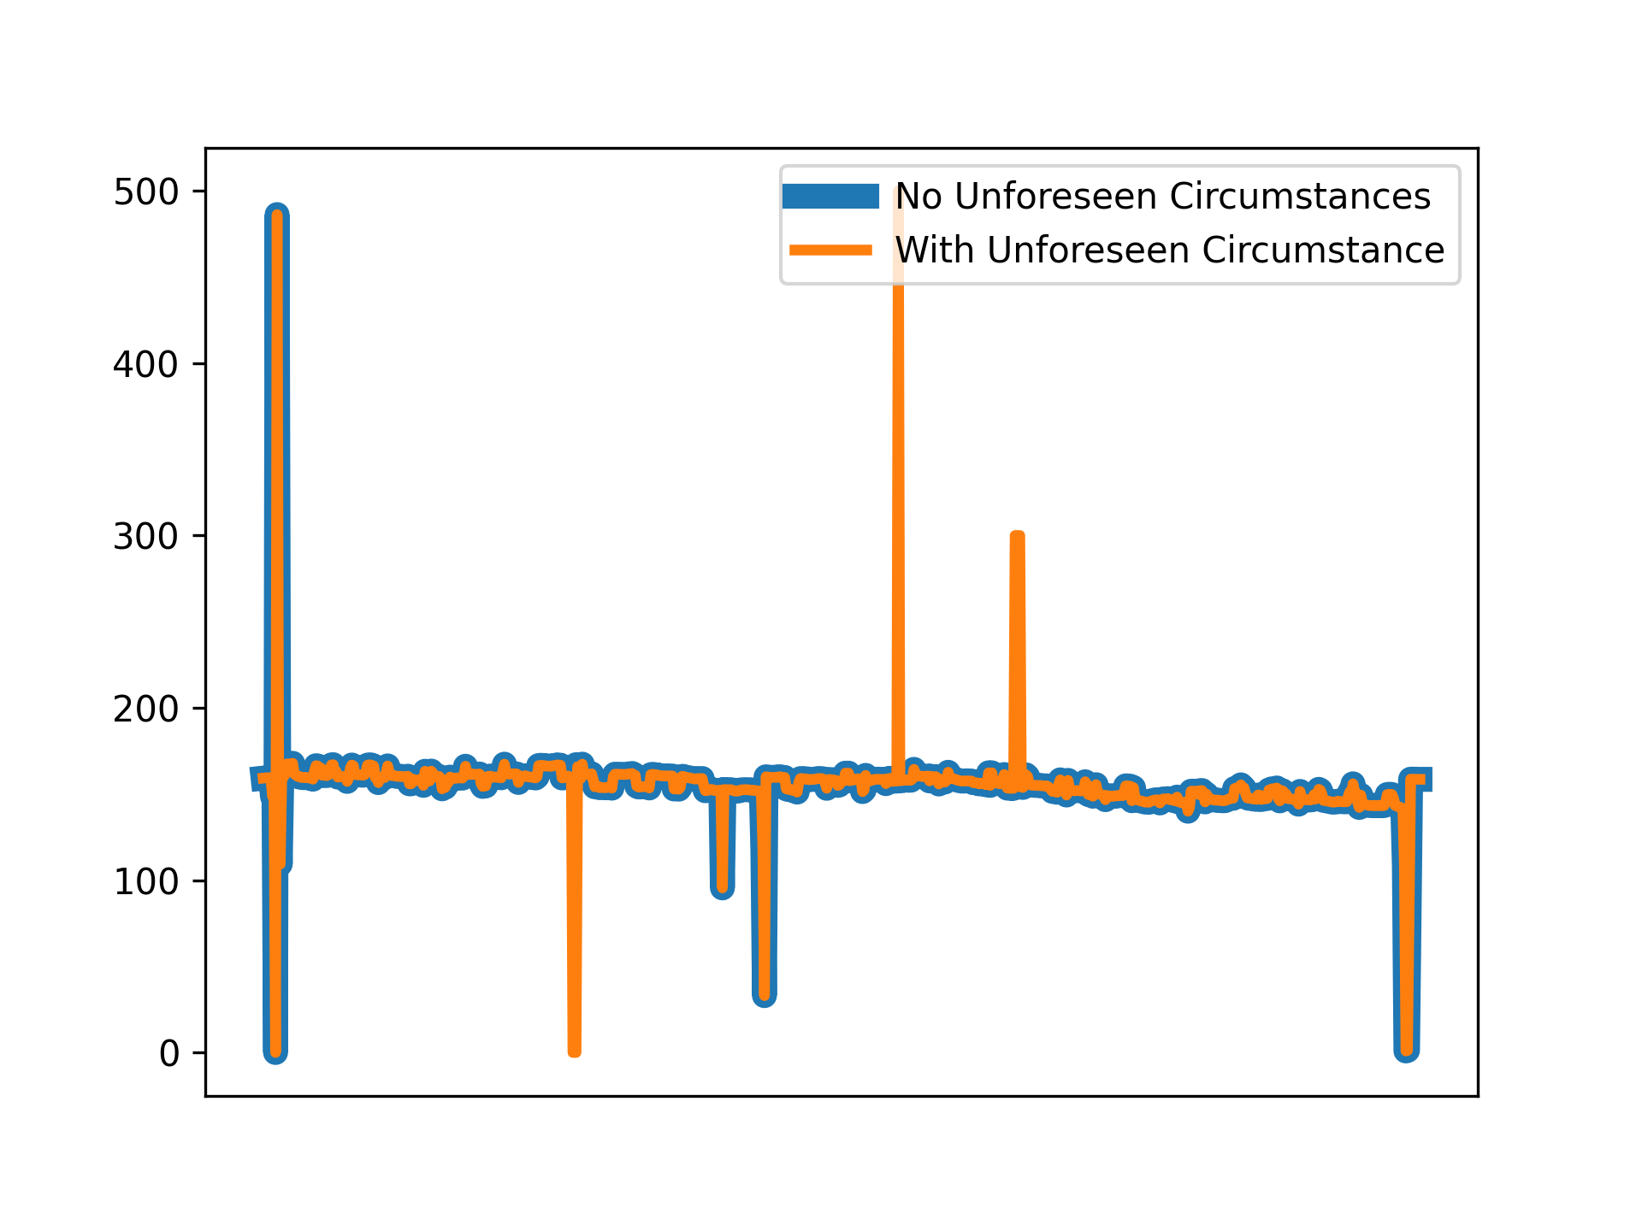
Question 1 Power scheduling – HOW SMART?
⭘⭘⬤
Resistance to accidents
Coping with unprecedented accidents with schedule(blue)
Up to 15% extra cost reduction
Notes:
Cst

Slide 9
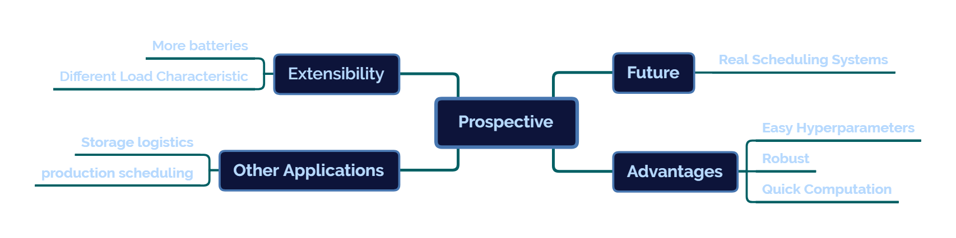
Open problem prospective
⬤ ⭘
Notes:
Cst

Slide 10
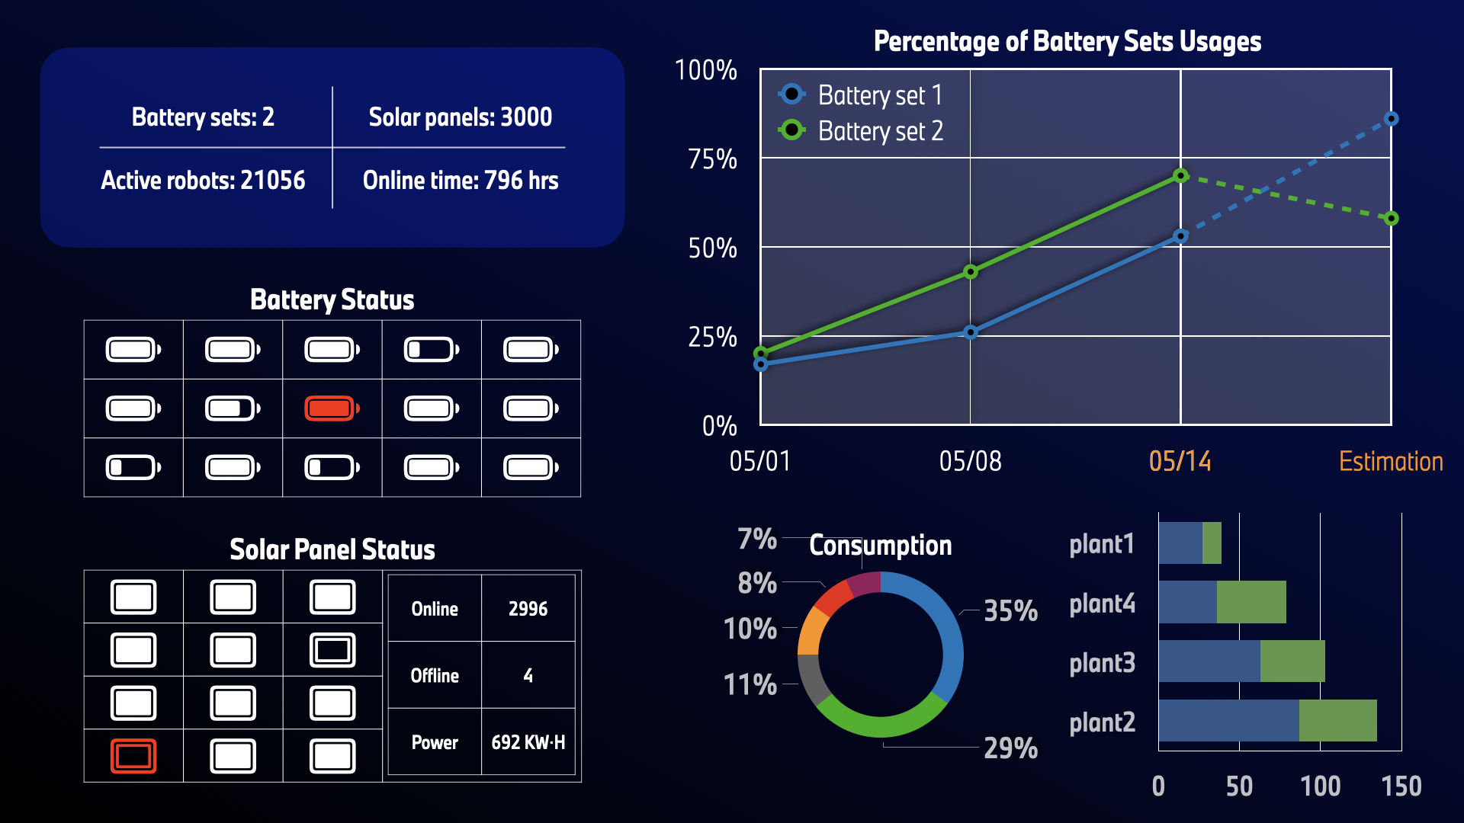
Open problem Demo of power scheduling system
⭘⬤
Notes:
Cst

Slide 11
Thanks!

